Slide 1
Blacktown Chinese Christian Church
Welcome to Our English Service 08.12.2024
English Service 9:45 – 11:00 am
Worship Songs: Passage: Speaker: Topic: Response Song: Announcements and Closing Prayer Benediction
How Great Is Our God King Of Kings I Will Boast In Christ Luke 1:5-25 TBA TBA TBA

Slide 2
BCCC english service

Slide 3

Please keep all phones on silent

Slide 4
How Great Is Our God
Chris Tomlin, Ed Cash, Jesse Reeves © 2004 Wondrously Made Songs (Admin. by Music Services, Inc.) Rising Springs Music (Admin. by SHOUT! Music Publishing Australia) Vamos Publishing (Admin. by SHOUT! Music Publishing Australia) worshiptogether.com songs (Admin. by SHOUT! Music Publishing Australia) CCLI Licence No. 5485849 . CCLI Song number: 4348399

Slide 5
Verse 1
The splendor of a King
Clothed in majesty
Let all the earth rejoice
All the earth rejoice

Slide 6
Verse 1
He wraps himself in Light
And darkness tries to hide
And trembles at His voice
Trembles at His voice

Slide 7
Chorus
How great is our God, sing with me
How great is our God, and all will see
How great, how great is our God

Slide 8
Verse 2
Age to age He stands
And time is in His hands
Beginning and the end
Beginning and the end

Slide 9
Verse 2
The Godhead Three in One
Father Spirit Son
The Lion and the Lamb
The Lion and the Lamb

Slide 10
Chorus
How great is our God, sing with me
How great is our God, and all will see
How great, how great is our God

Slide 11
Bridge
Name above all names
Worthy of our praise
My heart will sing
How great is our God (x2)

Slide 12
Chorus
How great is our God, sing with me
How great is our God, and all will see
How great, how great is our God (x2)

Slide 13
King Of Kings
Beau Lamshed, Jason Tarau © 2016 Citipointe Worship (Admin. by Crossroad Distributors Pty. Ltd.) CCLI Licence No. 5485849 . CCLI Song number: 7102191

Slide 14
Verse 1
In the darkness we were waiting
Without hope, without light
Till from heaven You came running
There was mercy in Your eyes

Slide 15
Verse 1
To fulfill the law and prophets
To a virgin came the word
From a throne of endless glory
To a cradle in the dirt

Slide 16
Chorus
Praise the Father, praise the Son
Praise the Spirit, three in one
God of glory, Majesty
Praise forever to the King of Kings

Slide 17
Verse 2
To reveal the kingdom coming
And to reconcile the lost
To redeem the whole creation
You did not despise the cross

Slide 18
Verse 2
For even in your suffering
You saw to the other side
Knowing this was our salvation
Jesus for our sake you died

Slide 19
Chorus
Praise the Father, praise the Son
Praise the Spirit, three in one
God of glory, Majesty
Praise forever to the King of Kings

Slide 20
Verse 3
And the morning that You rose
All of heaven held its breath
Till that stone was moved for good
For the Lamb had conquered death

Slide 21
Verse 3
And the dead rose from their tombs
And the angels stood in awe
For the souls of all who'd come
To the Father are restored

Slide 22
Verse 4
And the Church of Christ was born
Then the Spirit lit the flame
Now this gospel truth of old
Shall not kneel, shall not faint

Slide 23
Verse 4
By His blood and in His name
In His freedom I am free
For the love of Jesus Christ
Who has resurrected me

Slide 24
Chorus
Praise the Father, praise the Son
Praise the Spirit, three in one
God of glory, Majesty
Praise forever to the King of Kings

Slide 25
Outro
Praise forever to the King of Kings

Slide 26
I Will Boast In Christ
Reuben Morgan, Scott Ligertwood © 2016 Hillsong Music Publishing Australia CCLI Licence No. 5485849 . CCLI Song number: 7068427

Slide 27
Verse 1
All I have because of Jesus
All this promise
Won for me

Slide 28
Verse 1
When He paid the highest ransom
Once for always
For my freedom

Slide 29
Chorus
I will boast, in Christ alone
His righteousness
And not my own

Slide 30
Chorus
I will cling to Christ my hope
His mercy reigns
Now and forever

Slide 31
Verse 2
Love will never lose its power
All my failures
Could not erase

Slide 32
Verse 2
And now I walk within Your favour
Grace unending
My salvation

Slide 33
Chorus
I will boast, in Christ alone
His righteousness
And not my own

Slide 34
Chorus
I will cling to Christ my hope
His mercy reigns
Now and forever

Slide 35
Bridge 1
What can wash away my sin?
Nothing but the blood of Jesus
What can make me whole again?
Nothing but the blood of Jesus

Slide 36
Bridge 2
What can wash away my sin?
Nothing but the blood of Jesus
What can make me whole again?
Nothing but the blood of Jesus

Slide 37
Bridge 2
Nothing but the blood of Jesus

Slide 38
Chorus
I will boast, in Christ alone
His righteousness
And not my own

Slide 39
Chorus
I will cling to Christ my hope
His mercy reigns
Now and forever

Slide 40
Bridge
What can wash away my sin?
Nothing but the blood of Jesus
What can make me whole again?
Nothing but the blood of Jesus

Slide 41
Outro
O precious is the flow
That makes me white as snow
No other fount I know
Nothing but the blood of Jesus

Slide 42
Outro
Nothing but the blood of Jesus

Slide 43
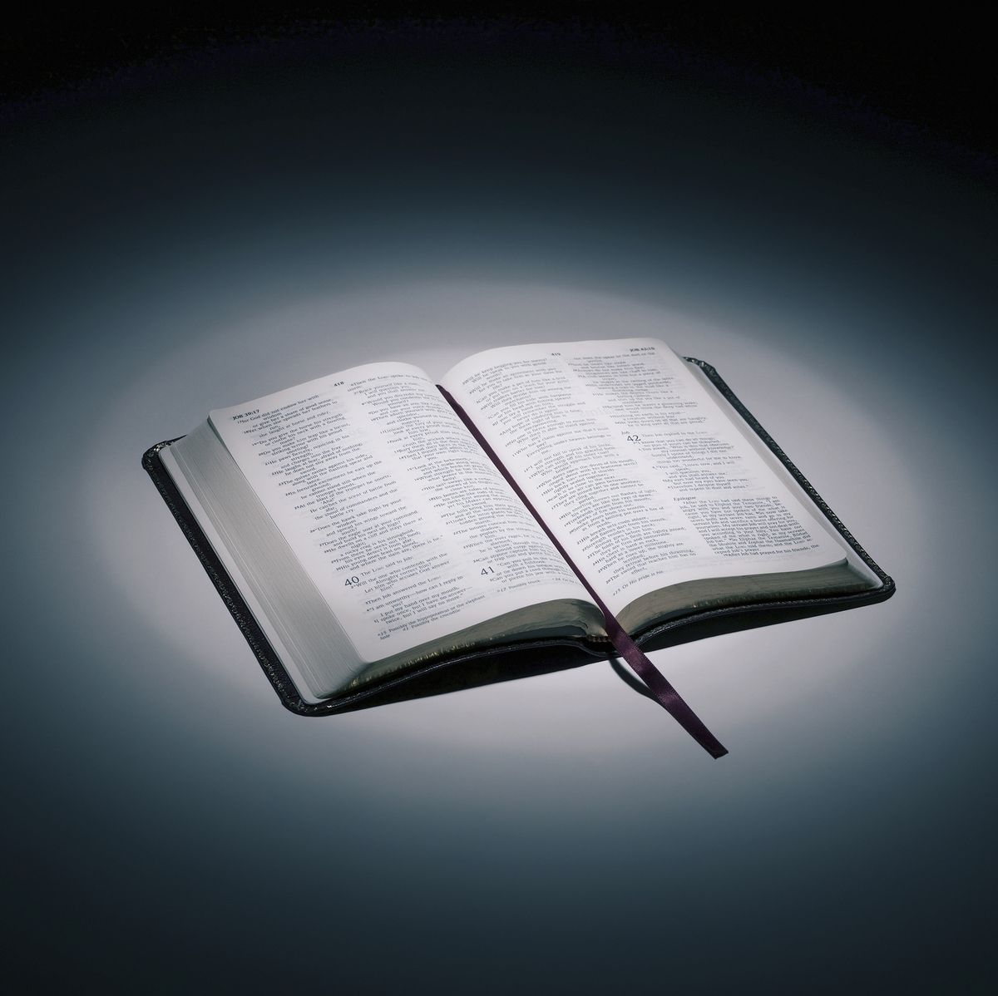
Bible reading

Slide 44
Bible reading: Luke 1:5-25
⁵ In the time of Herod king of Judea there was a priest named Zechariah, who belonged to the priestly division of Abijah; his wife Elizabeth was also a descendant of Aaron. ⁶ Both of them were righteous in the sight of God, observing all the Lord’s commands and decrees blamelessly.

Slide 45
Bible reading: Luke 1:5-25
⁷ But they were childless because Elizabeth was not able to conceive, and they were both very old.
⁸ Once when Zechariah’s division was on duty and he was serving as priest before God,

Slide 46
Bible reading: Luke 1:5-25
⁹ he was chosen by lot, according to the custom of the priesthood, to go into the temple of the Lord and burn incense. ¹⁰ And when the time for the burning of incense came, all the assembled worshipers were praying outside.

Slide 47
Bible reading: Luke 1:5-25
¹¹ Then an angel of the Lord appeared to him, standing at the right side of the altar of incense. ¹² When Zechariah saw him, he was startled and was gripped with fear.

Slide 48
Bible reading: Luke 1:5-25
¹³ But the angel said to him: “Do not be afraid, Zechariah; your prayer has been heard. Your wife Elizabeth will bear you a son, and you are to call him John. ¹⁴ He will be a joy and delight to you, and many will rejoice because of his birth,

Slide 49
Bible reading: Luke 1:5-25
¹⁵ for he will be great in the sight of the Lord. He is never to take wine or other fermented drink, and he will be filled with the Holy Spirit even before he is born. ¹⁶ He will bring back many of the people of Israel to the Lord their God.

Slide 50
Bible reading: Luke 1:5-25
¹⁷ And he will go on before the Lord, in the spirit and power of Elijah, to turn the hearts of the parents to their children and the disobedient to the wisdom of the righteous—to make ready a people prepared for the Lord.”
¹⁸ Zechariah asked the angel, “How can I be sure of this? I am an old man and my wife is well along in years.”

Slide 51
Bible reading: Luke 1:5-25
¹⁹ The angel said to him, “I am Gabriel. I stand in the presence of God, and I have been sent to speak to you and to tell you this good news. ²⁰ And now you will be silent and not able to speak until the day this happens, because you did not believe my words, which will come true at their appointed time.”

Slide 52
Bible reading: Luke 1:5-25
²¹ Meanwhile, the people were waiting for Zechariah and wondering why he stayed so long in the temple. ²² When he came out, he could not speak to them. They realized he had seen a vision in the temple, for he kept making signs to them but remained unable to speak.

Slide 53
Bible reading: Luke 1:5-25
²³ When his time of service was completed, he returned home. ²⁴ After this his wife Elizabeth became pregnant and for five months remained in seclusion.

Slide 54
Bible reading: Luke 1:5-25
²⁵ “The Lord has done this for me,” she said. “In these days he has shown his favor and taken away my disgrace among the people.”

Slide 55
Announcements

Slide 56





Account name: Blacktown Chinese Christian Church
Account number: 4216 50263
Offering
BSB: 112 - 879
Please put in "offering" as the reference
The offering box is available at the back of the hall

Slide 57
Prayer points

Slide 58
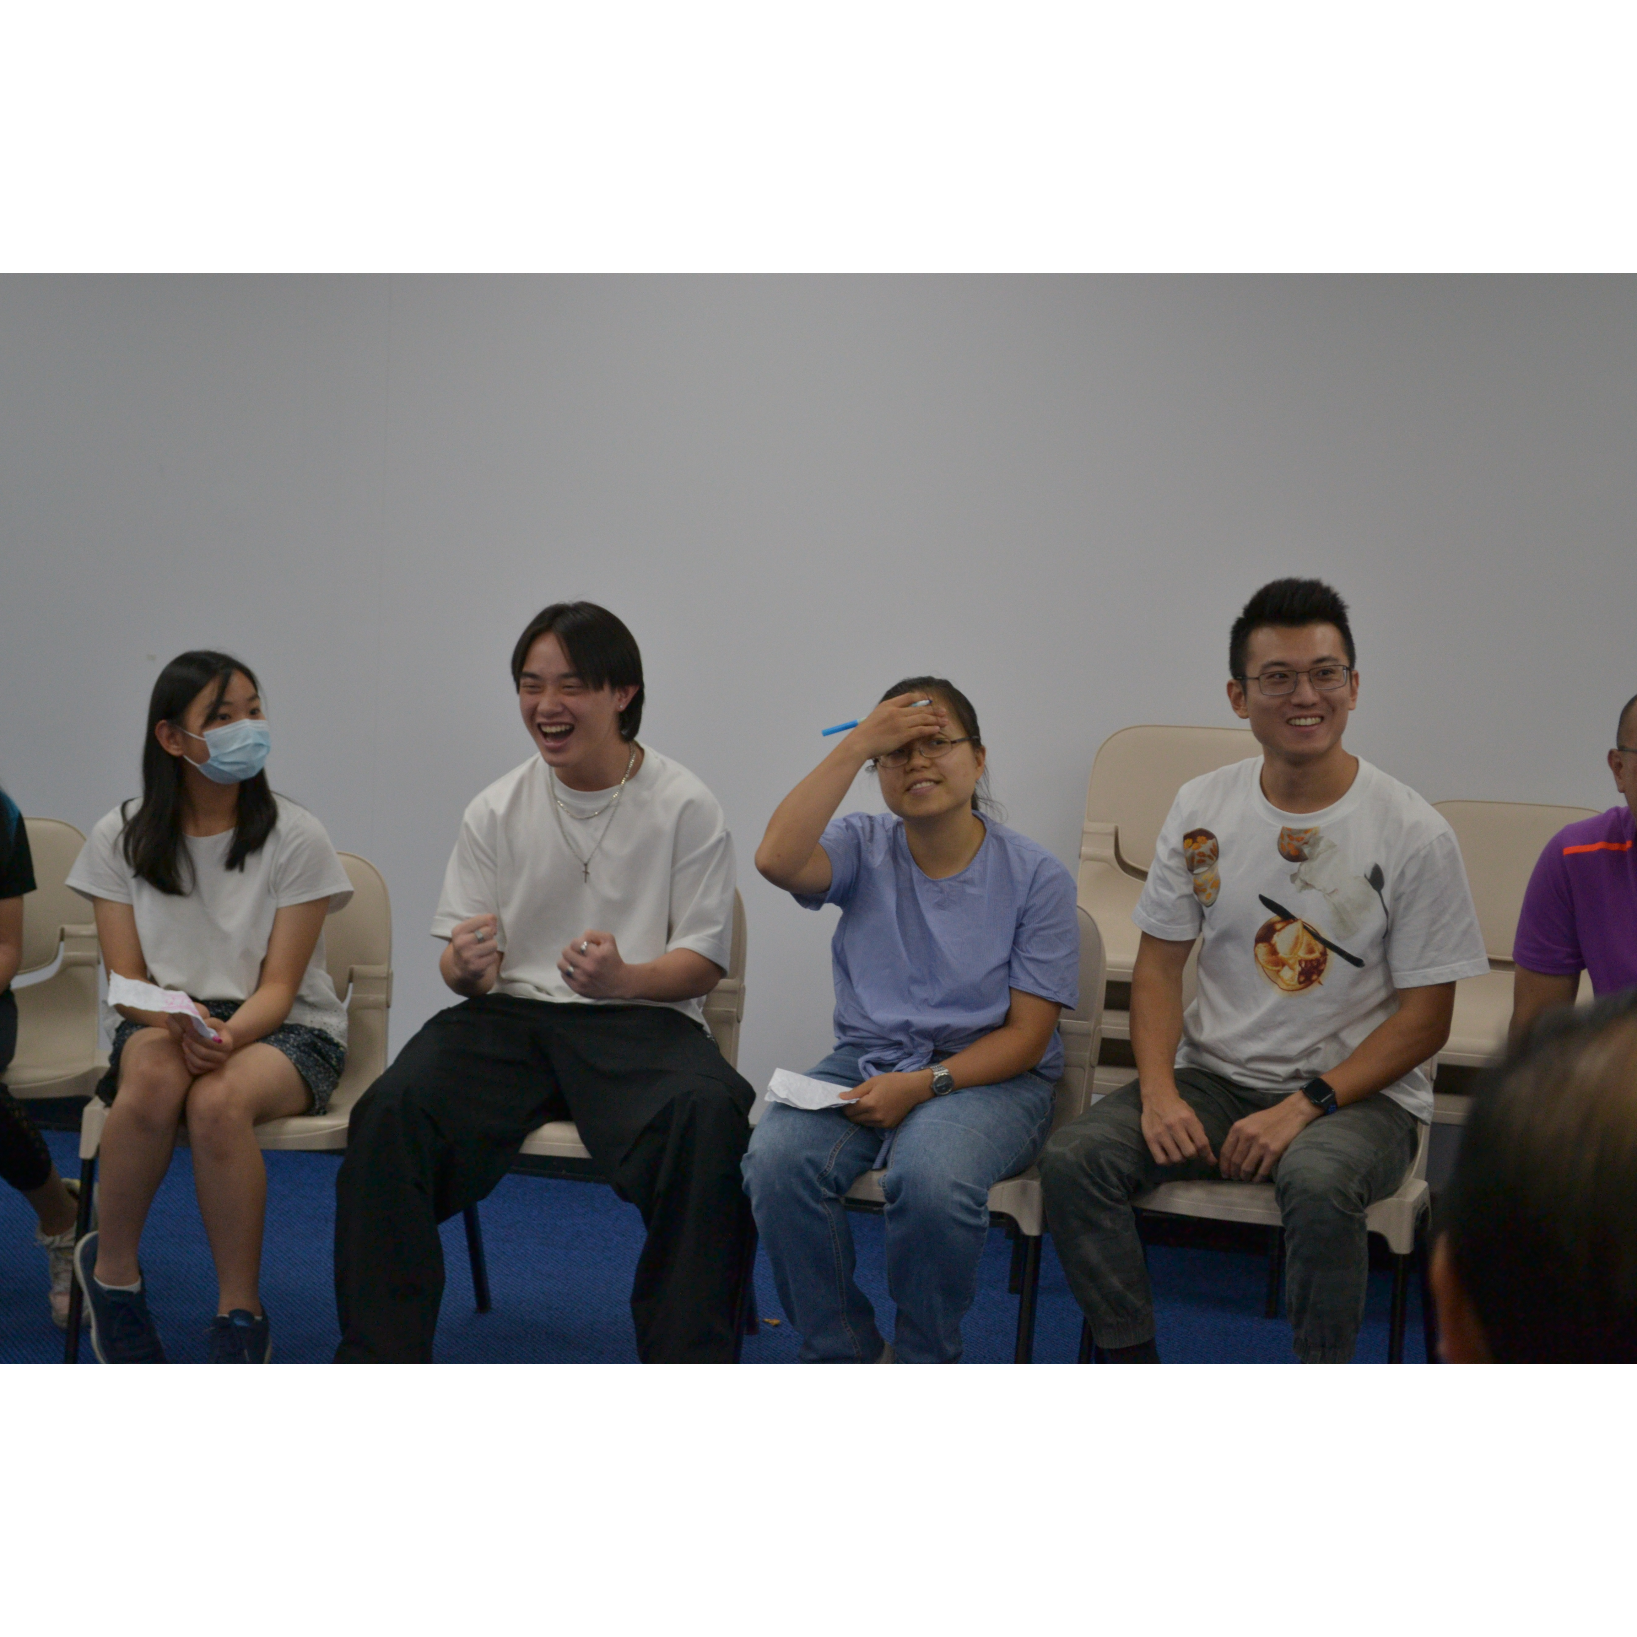
Mingle time!

